Slide 1

CSS Styling Deep Dive: Colors, Text, Units, and Box Model
BY : Anjali Sharma

Slide 2

Let’s Check Yesterday’s coding practice

Slide 3
CSS Color Properties
color: changes the text color
background-color: changes the background of an element`”
Example :
h1 {
color: red;
background-color: yellow;
}
CSS Color Systems :
Color : blue, yellow
HEX Code : #ff0000 (red) → Hexadecimal format starts with # followed by 6 character
RGB : rgb(255, 0, 0) → Red, Green, Blue, values from 0–255

Slide 4
Text Properties
font-size → for adjusting text size (25px, 30px etc….)
font-weight → adjusting font weight(bold, lighter, bolder, 100-900)
font-style → normal , italic , oblique
text-align → left, right, center, justify
text-decoration → underline, overline, line-through
line-height (control spacing between line) → 1.5, 20px, 120%

Slide 5
Units in CSS
Absolute units : (Fixed size, not affected by screen or parent)
Pixel (px) :- 96px = 1 inch = 2.54 cm
Relative units : (Change based on parent or screen size, For responsive design)
% : Percentage of parent element : width: 50%
Em : Relative to parent’s font size : font-size: 2em
Rem: Relative to root (html) font size: font-size: 1.5rem
vw%: of viewport width : width: 50vw
vh% : of viewport height : height: 100vh

Slide 6
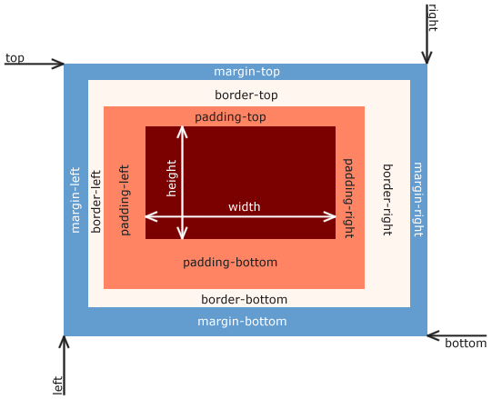
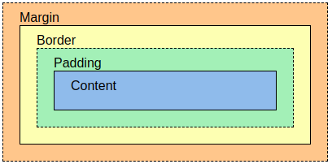
Box Model
“Everything in HTML is a box. The box model helps you understand how spacing works
padding: space inside the element
border: edge line around the box
margin: space outside the box
height , width of box
content ( text , img ) which size control by height and width

Slide 7
Padding : ( Space inside the border, around the content , Creates breathing room inside the element )
padding: 20px; /* all sides */
padding: 10px 20px; /* top-bottom, left-right */
padding: 10px 15px 20px 25px; /* top, right, bottom, left */
Border : (The line that goes around the padding and content Can have width, style, and color)
border: 2px solid black;
border-top: 3px dashed red;
BORDER-STYLE → solid, dashed, dotted, none, double, groove, etc.
Similarly border-bottom, border-right etc …..

Slide 8
Margin : (Space outside the border (gap between this element and others))
margin: 10px; /* all sides */
margin: 0 auto; /* top-bottom 0, left-right auto — used to center */
margin: 10px 15px 20px 25px; /* top right bottom left */
Box Model Example :
<div class="box">Hello!</div>
.box {
width: 200px;
height: 100px;
padding: 20px;
border: 2px solid blue;
margin: 30px;
}

Slide 9
Box-sizing property :
width + padding + border = actual width of an element height + padding + border = actual height of an element
element often appears bigger than you have set….
.div1 { width: 300px; height: 100px; border: 1px solid blue; } .div2 { width: 300px; height: 100px; padding: 50px; border: 1px solid red; }
// box-sizing: border-box;

Slide 10
Display Property : (This controls how elements behave on the page )
block: takes full width (e.g., div, p)
inline: flows with text (e.g., span, a)
inline-block: Sits inline like inline, but you can set width & height
none: hides the element
.box {
display: block ; inline; inline-block; none;
}
Visibility Property : (hides the element but keeps space )
Example:
visibility: hidden hides the element but keeps space
display: none hides the element and removes space”

Slide 11
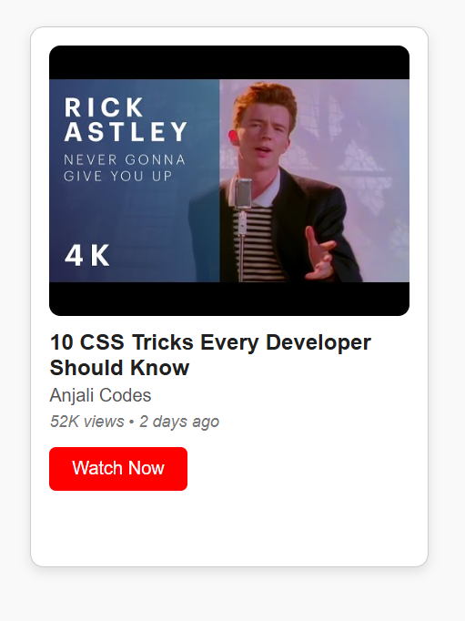
Coding Practice
Your task is to build a YouTube-style video card using everything we learned today:
It should have:
A video thumbnail
A title, channel name, and description
A views + time line
A Watch Now button
Styling with colors, units, text properties, box model, and display
Hide a secret tag using visibility: hidden (#trending)

Slide 12
THANK YOU
ALL THE BEST !!!

